Slide 1

CS 53D Intro To Computer Forensics
Tim Ryan
ryantimothy@fhda.edu

Slide 2
CS53D: Intro to Computer Forensics
Week 6 Agenda
Course and Assignment Review
Twitter Hack Details
CMU Software Engineering Institute
EnCase Forensic Tool
Private Surveillance for Sale
Forensic Investigators: Krebs, Mikko, Schneier
Conclusion

Slide 3
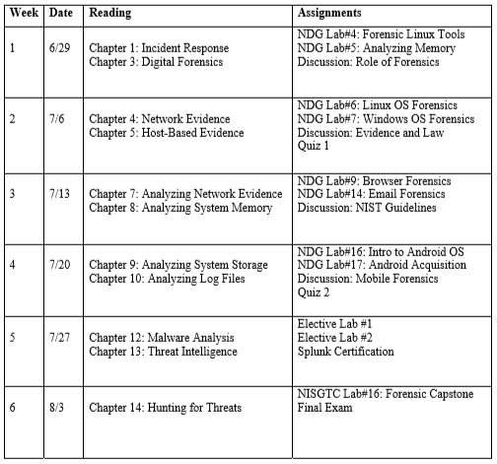
All Assignments Due Saturday, August 8th!!

Slide 4
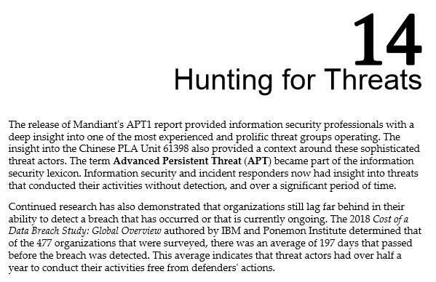
Packt Textbook: Digital Forensics and Incident Response

Slide 5
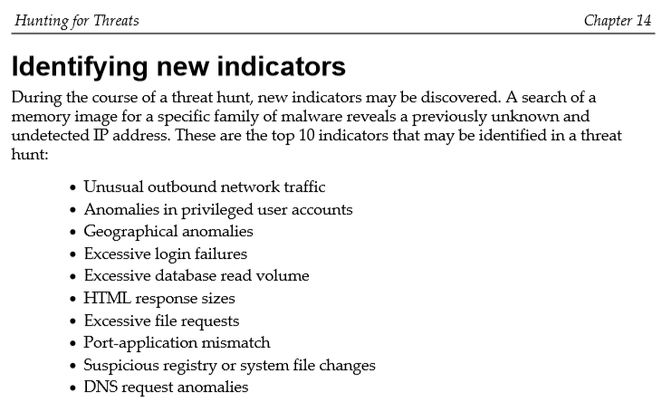
Manual Process or Automated?
What Tools Are Required?

Slide 6
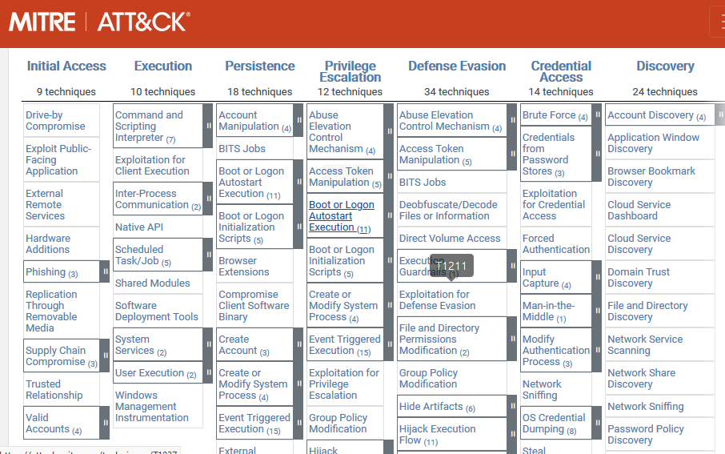
ATT&CK: Adversarial Tactics, Techniques, and Common Knowledge
Source: https://attack.mitre.org/

Slide 7
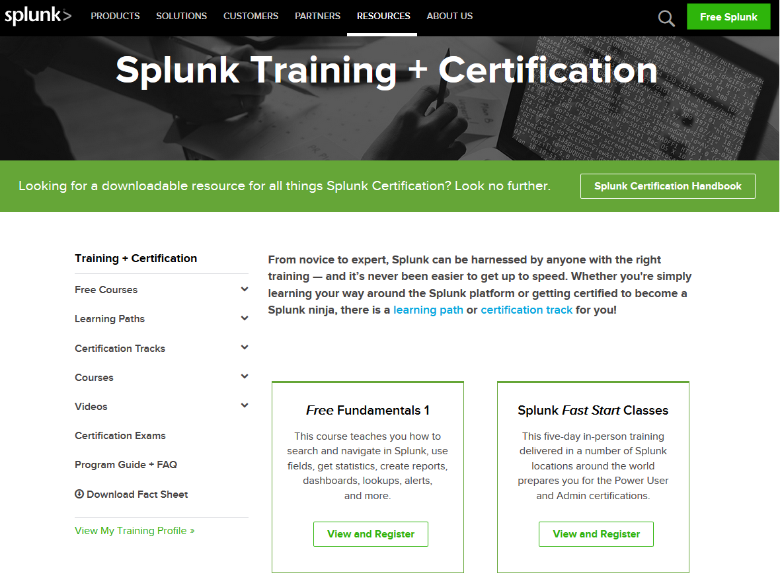
https://www.splunk.com/en_us/training.html

Slide 8
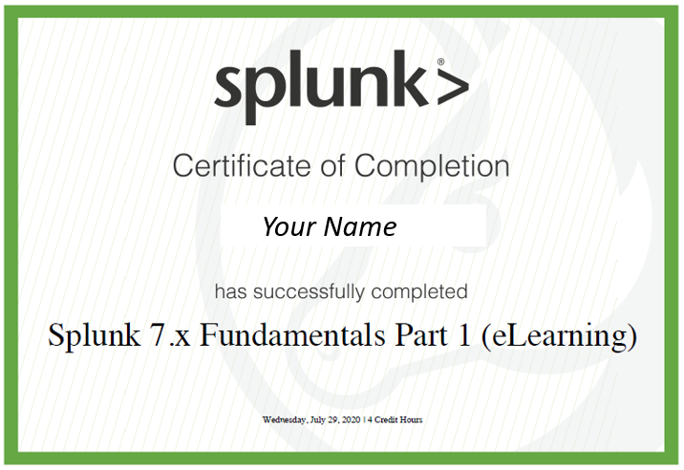
Submit Certificate For Grading

Slide 9

Source: https://www.splunk.com/en_us/download.html

Slide 10
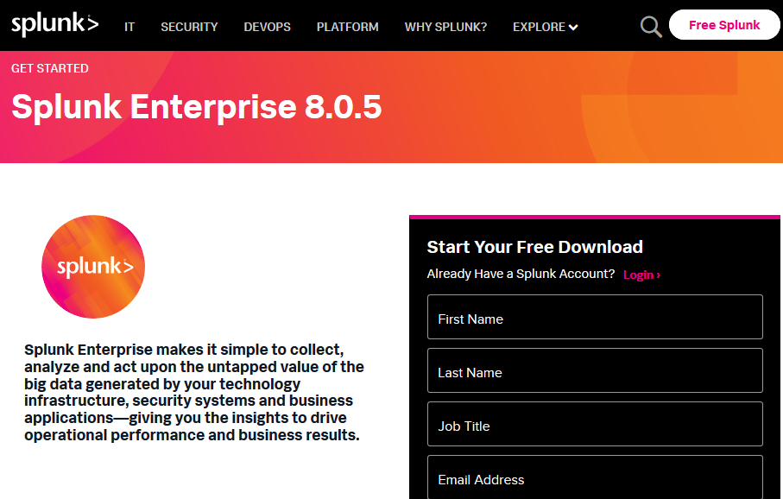

Slide 11
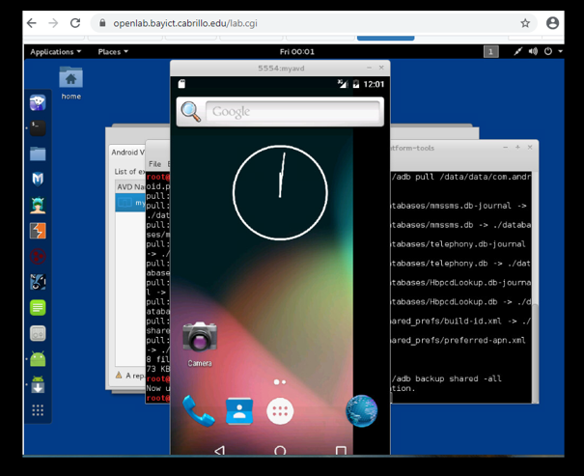
Lab #17 – Android Simulator

Slide 12
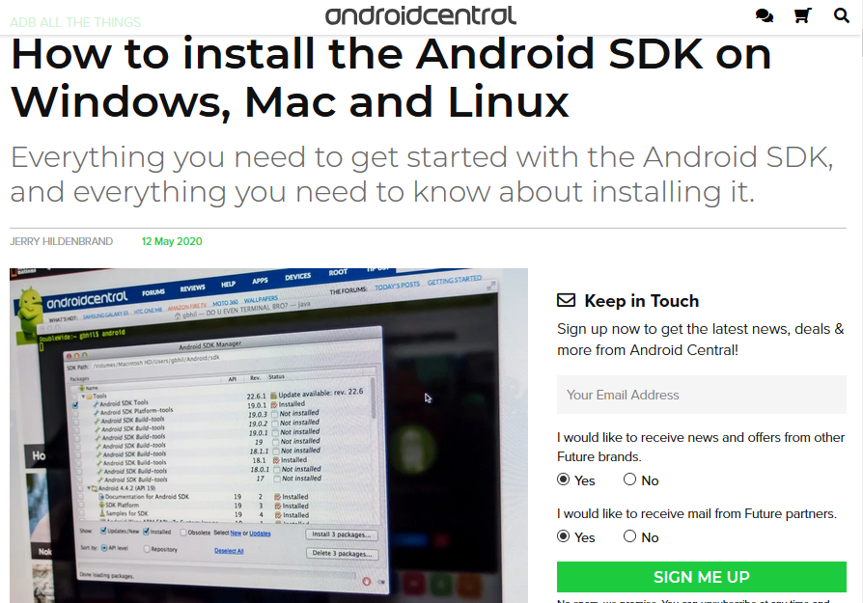
Source: https://www.androidcentral.com/installing-android-sdk-windows-mac-and-linux-tutorial

Slide 13
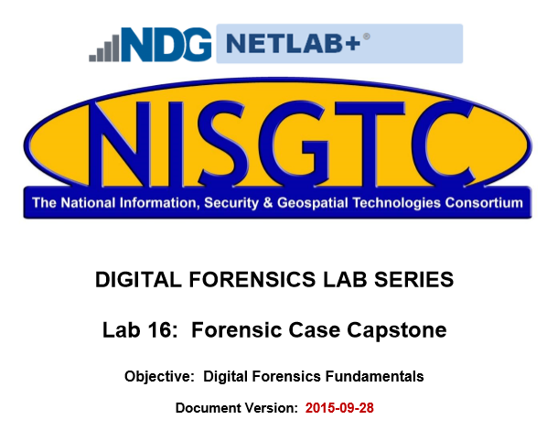
Final Lab Assigment

Slide 14
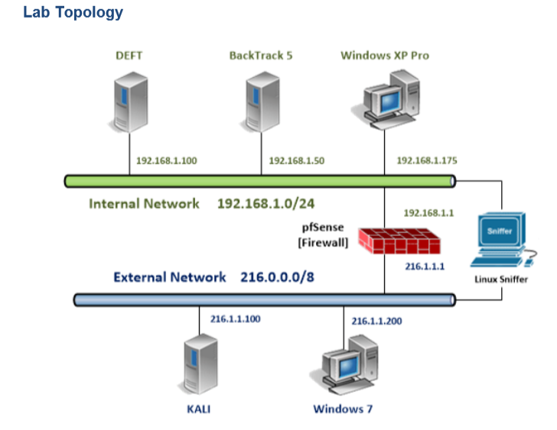

Slide 15
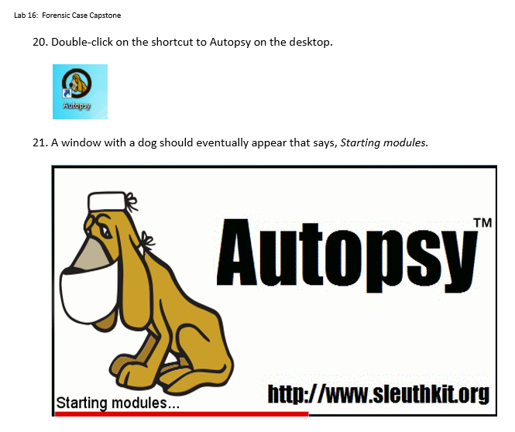

Slide 16
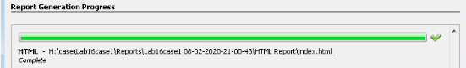
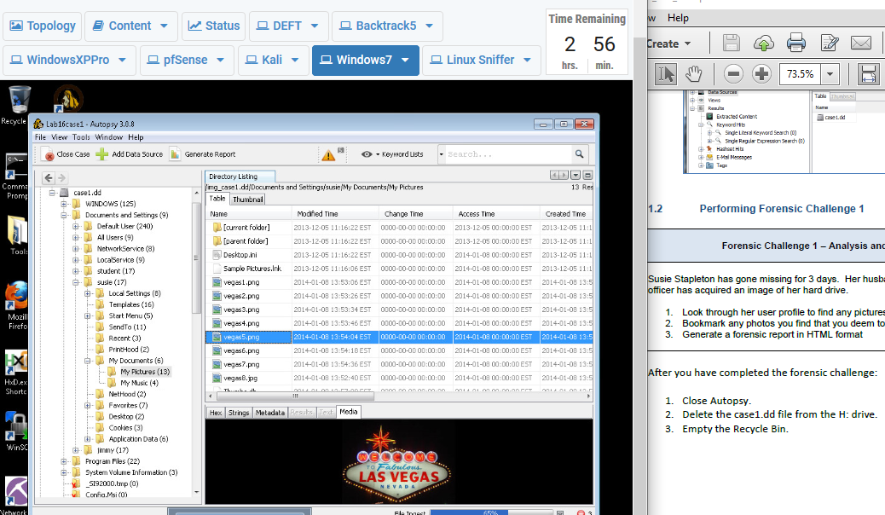
Bookmark Process: Right Click – Tag File – Quick Tag - Bookmark

Slide 17
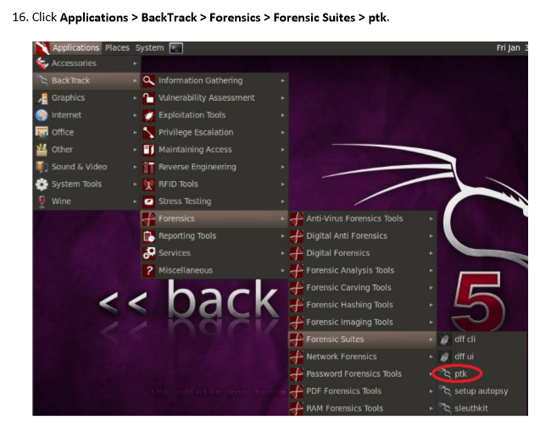

Slide 18
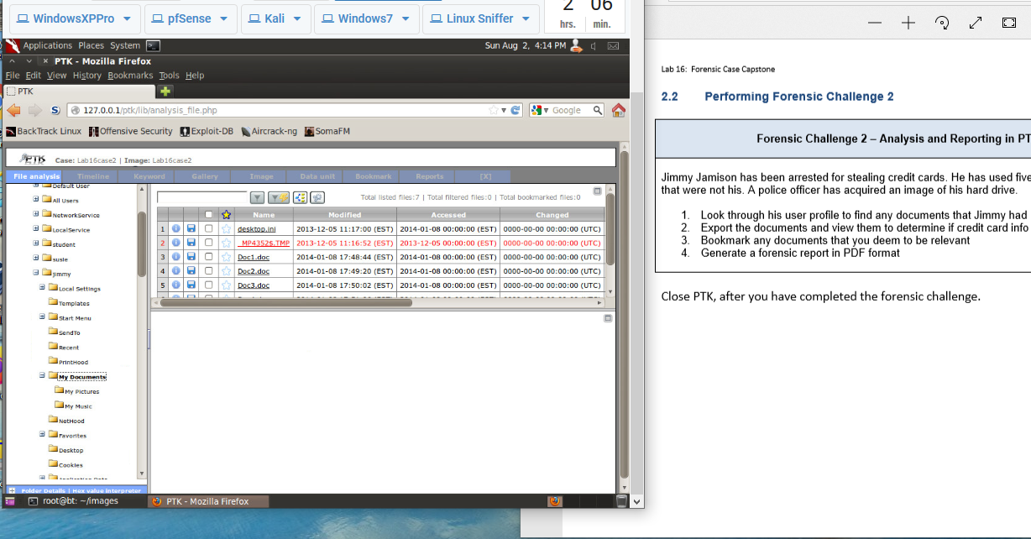

Slide 19
Final Exam Summary
Multiple-Choice Question Topics:
Laws
Volatile Data
File Formats
Password Retention
Mobile Devices
Essay Question Topic:
Cloud Service Forensics

Slide 20
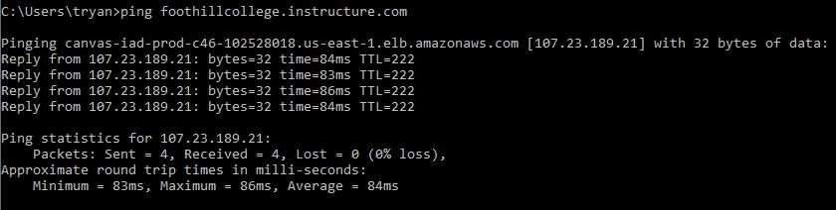
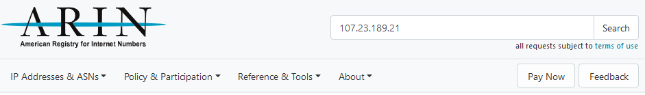
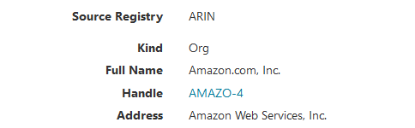
Final Exam Prep – Where Is Canvas?

Slide 21
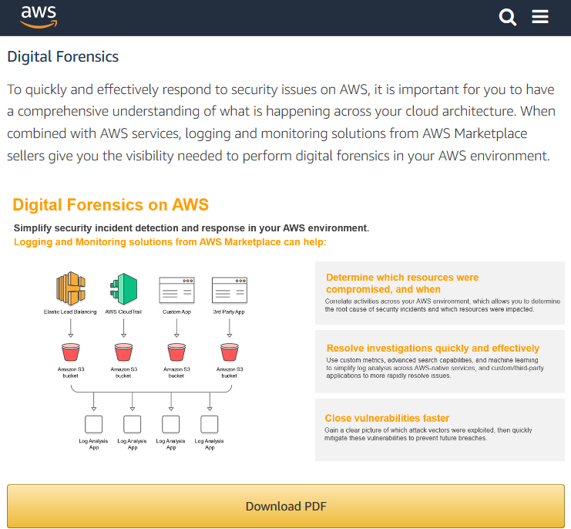
Final Exam Prep – Essay Question

Slide 22
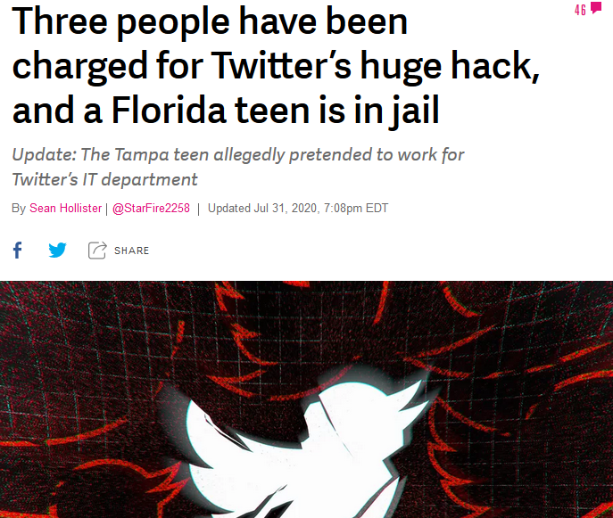
Source: https://www.theverge.com/2020/7/31/21349920/twitter-hack-arrest-florida-teen-fbi-irs-secret-service

Slide 23
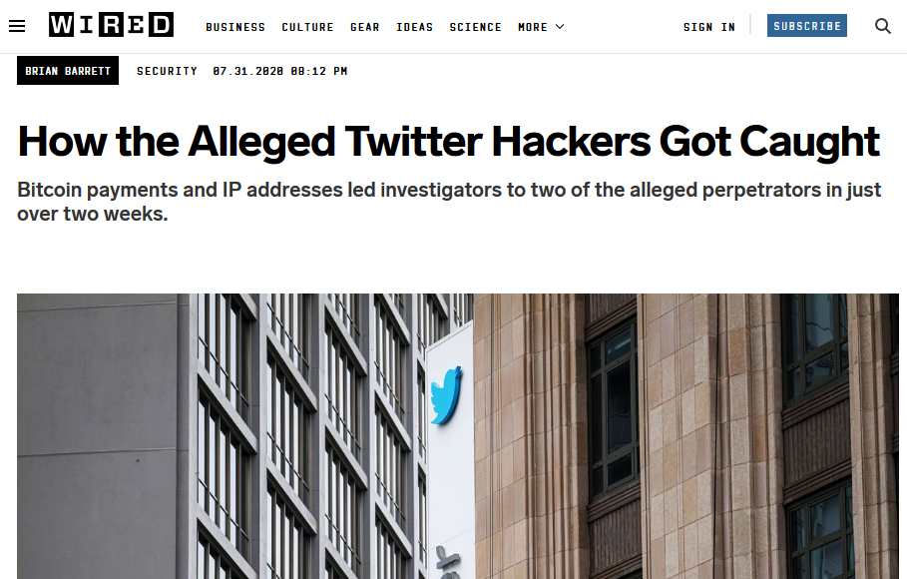
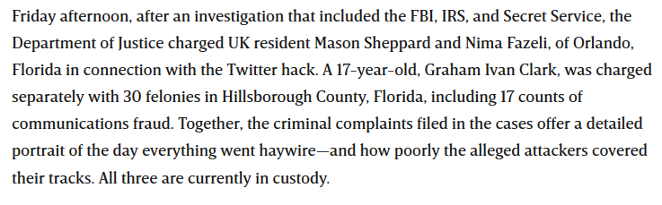
Source: https://www.wired.com/story/how-alleged-twitter-hackers-got-caught-bitcoin/

Slide 24
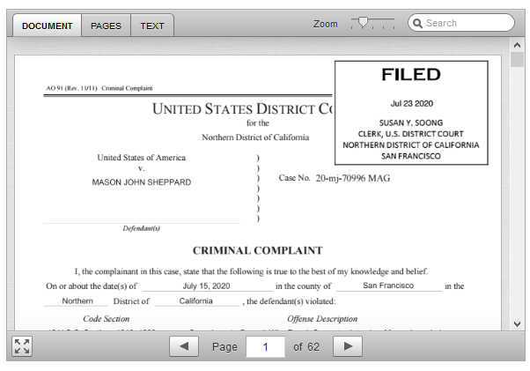
(You Don’t Want Your Name Here)

Slide 25
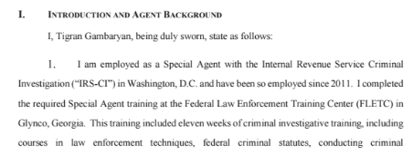
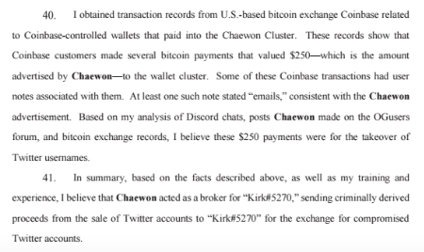

Slide 26
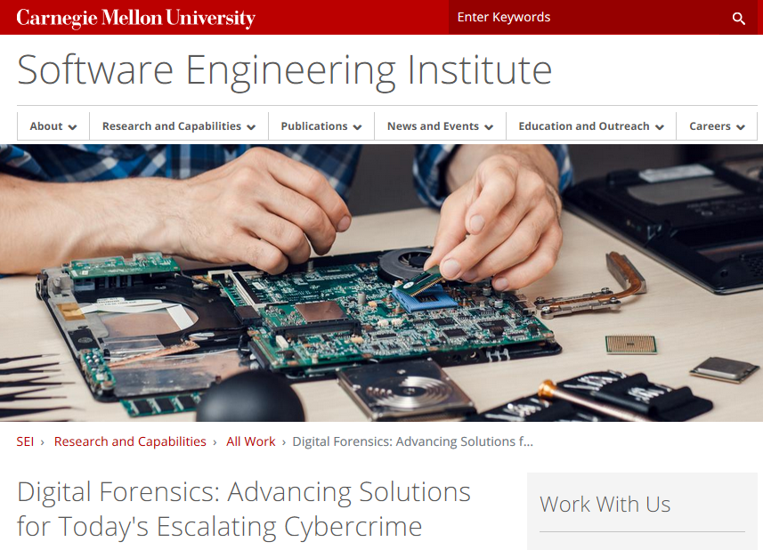
Source: https://www.sei.cmu.edu/research-capabilities/all-work/display.cfm?customel_datapageid_4050=21373

Slide 27
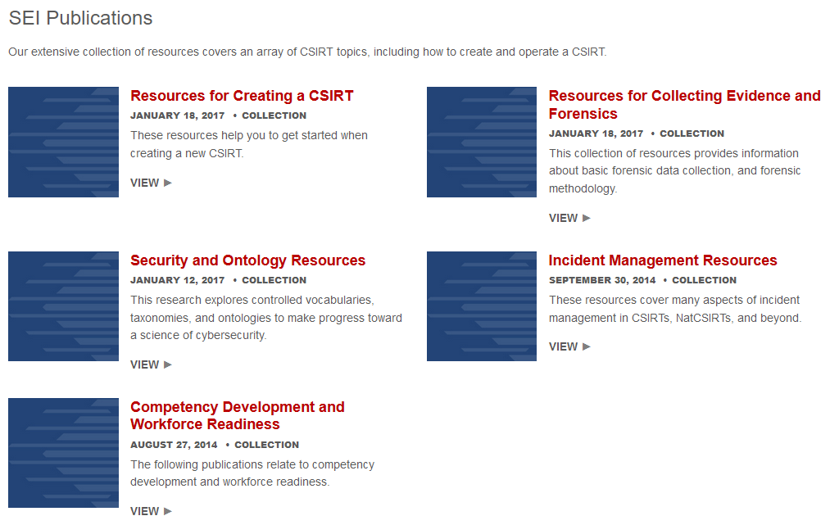
Source: https://www.sei.cmu.edu/education-outreach/computer-security-incident-response-teams/index.cfm

Slide 28
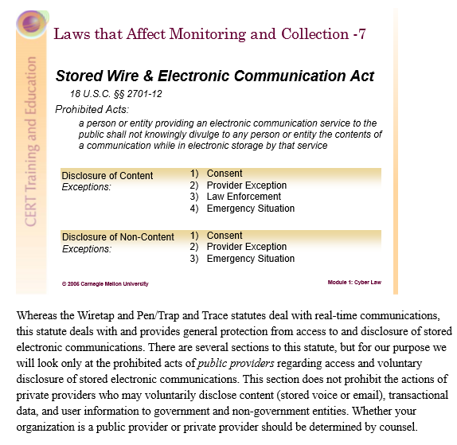
Example: Resources for Collecting Evidence and Forensics

Slide 29
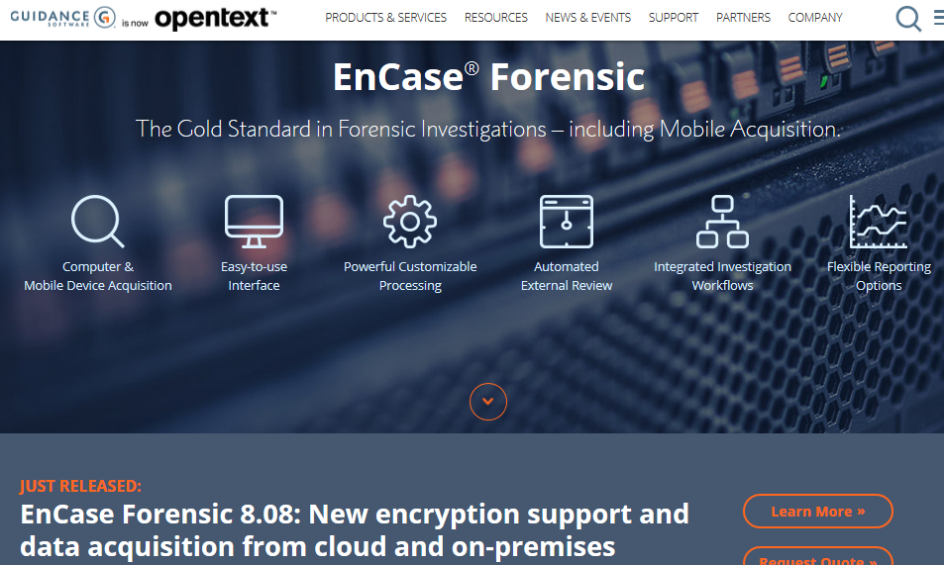
Source: https://www.guidancesoftware.com/encase-forensic

Slide 30
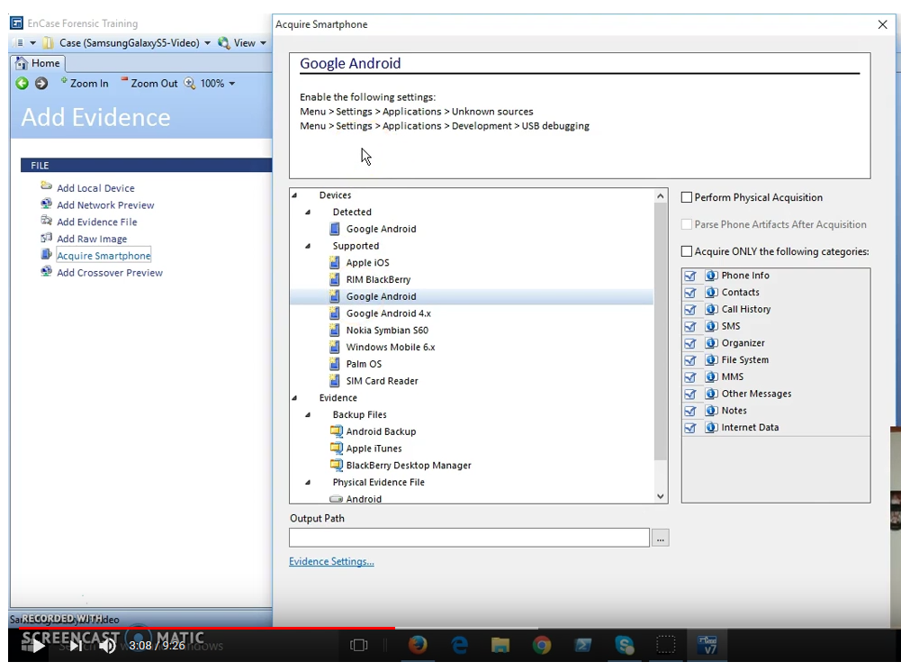
EnCase Mobile Acquisition Demo
Source: https://www.youtube.com/watch?v=xjPzM0ebraw

Slide 31
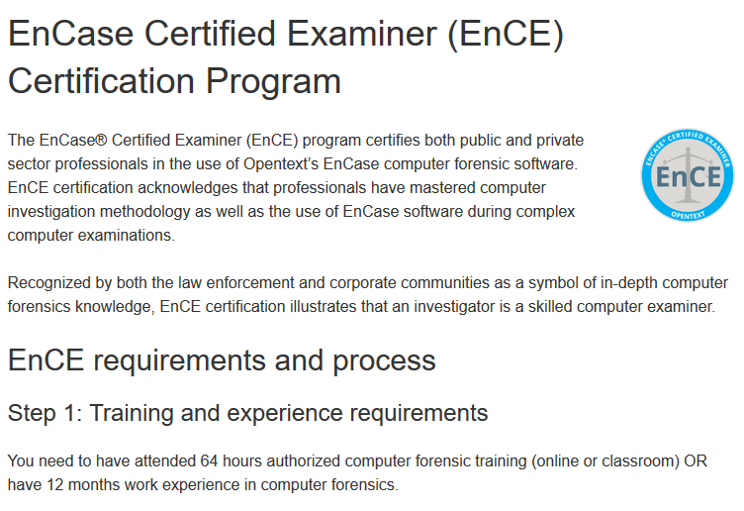
Source: https://www.opentext.com/products-and-solutions/services/training-and-learning-services/encase-training/examiner-certification

Slide 32
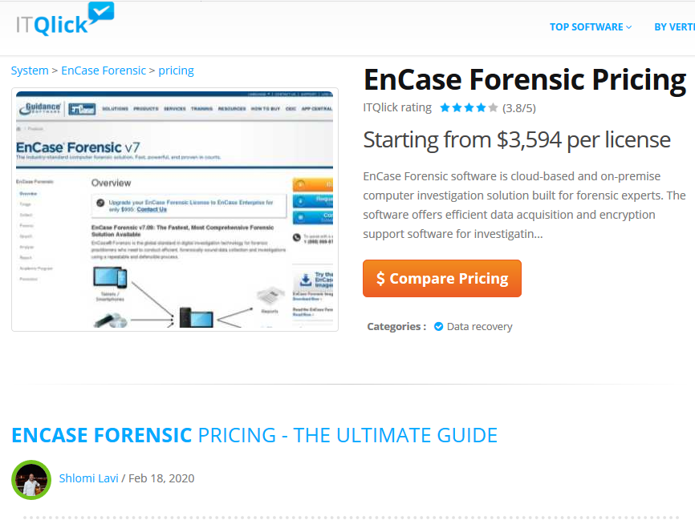
Source: https://www.itqlick.com/encase-forensic/pricing

Slide 33
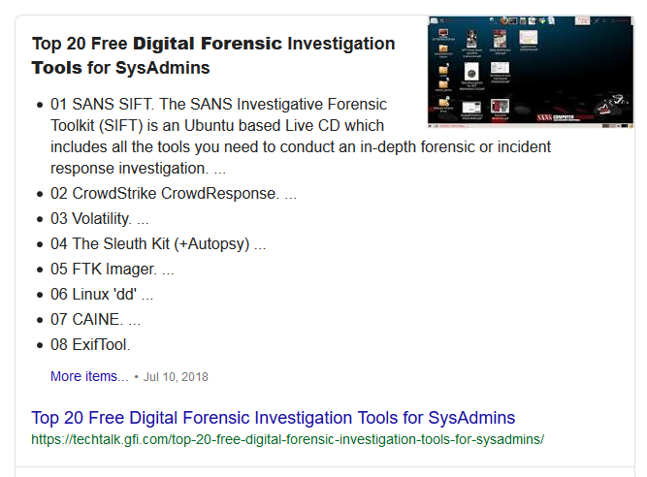
Source: https://techtalk.gfi.com/top-20-free-digital-forensic-investigation-tools-for-sysadmins/

Slide 34
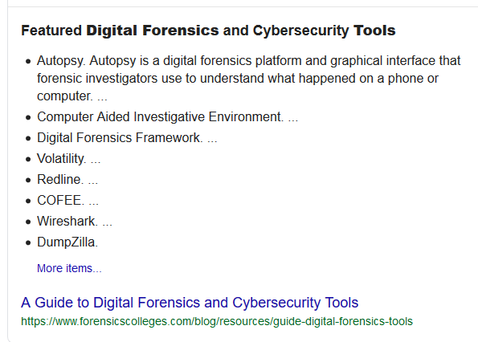
Source: https://www.forensicscolleges.com/blog/resources/guide-digital-forensics-tools

Slide 35
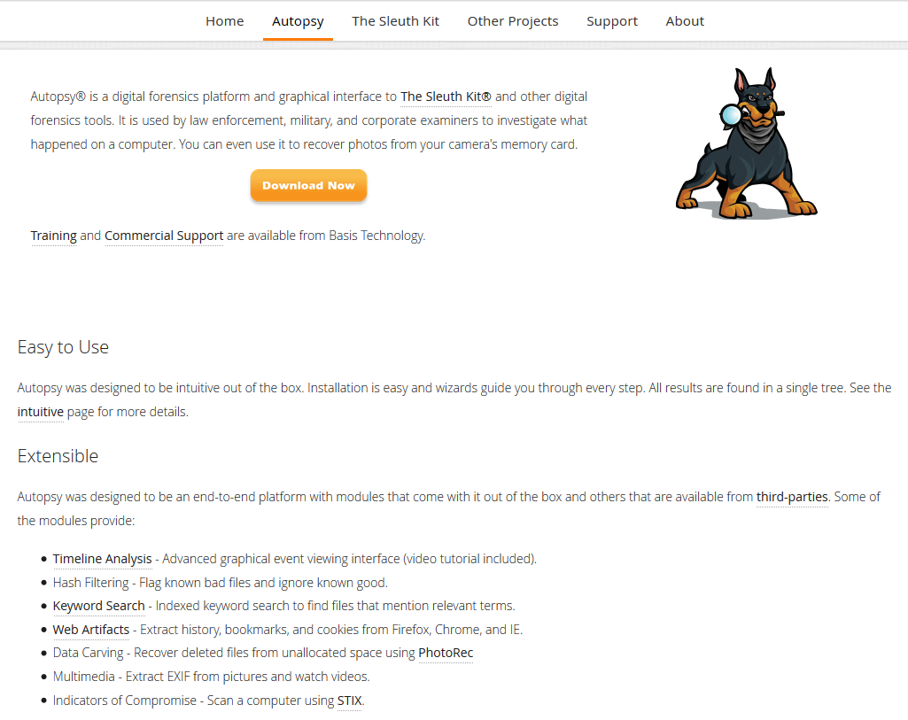
Autopsy – Download to Isolated VM (i.e., VirtualBox)
Source: https://www.sleuthkit.org/autopsy/

Slide 36
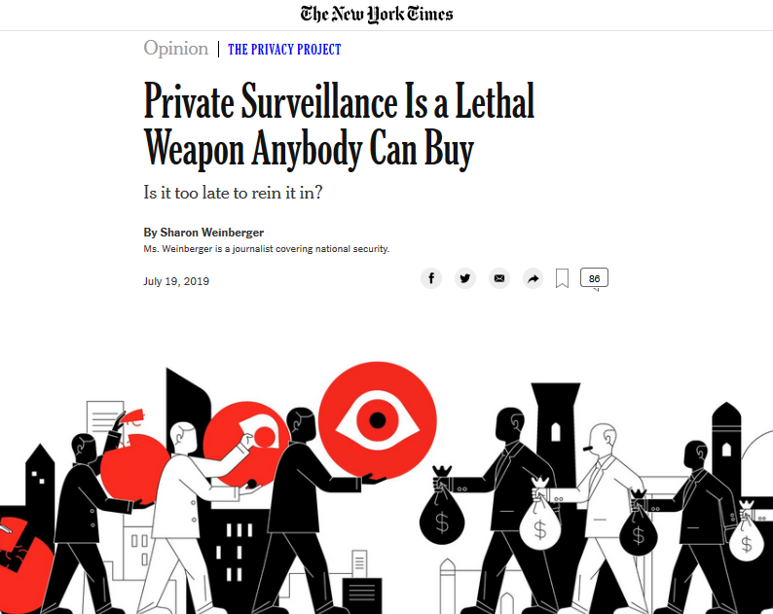
Source: https://www.nytimes.com/2019/07/19/opinion/private-surveillance-industry.html

Slide 37
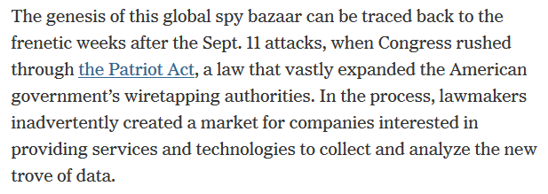
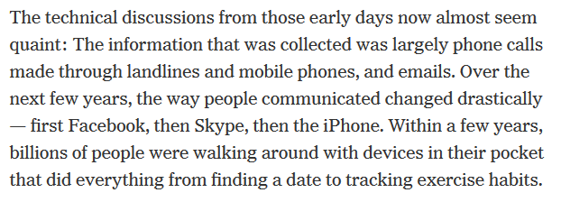

Slide 38
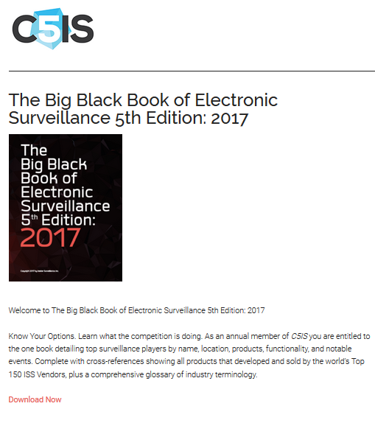
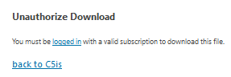
Don’t Let This Stop You
Just Search On Google!
See Files/Course Documents

Slide 39
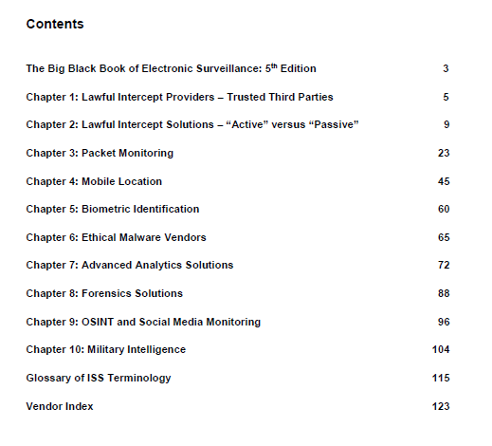

Slide 40
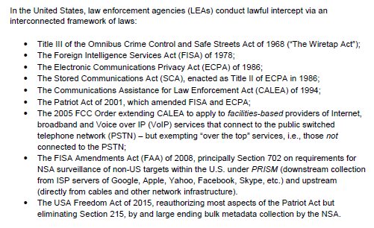

Slide 41
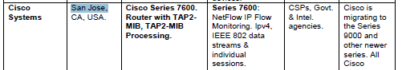
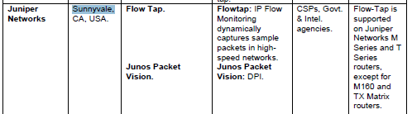
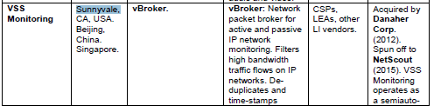

Slide 42
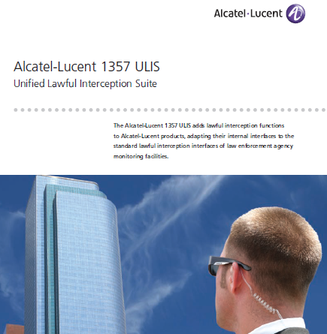
Source: https://wikileaks.org/spyfiles/document/alcatel-lucent/81_alcatel-lucent-1357-ulis
-unified-lawful-interception-suite/81_alcatel-lucent-1357-ulis-unified-lawful-interception-suite.pdf

Slide 43
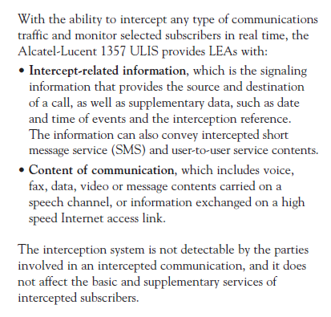

Slide 44
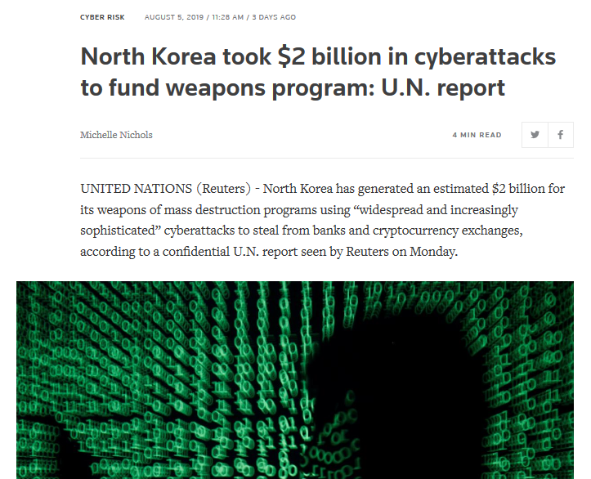
Current Cybersecurity Events -> Who Needs NetFlix?
Source: https://www.reuters.com/article/us-northkorea-cyber-un/north-korea-took-2-billion
-in-cyberattacks-to-fund-weapons-program-u-n-report-idUSKCN1UV1ZX?wpisrc=nl_cybersecurity202&wpmm=1

Slide 45
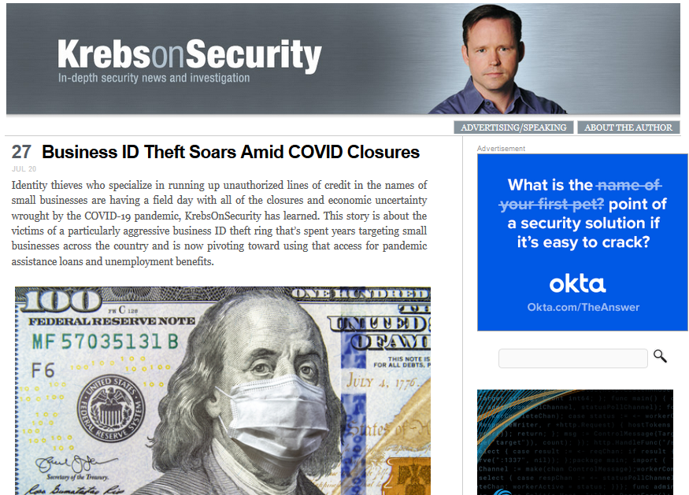
Forensics/Security Researcher
Source: https://krebsonsecurity.com/

Slide 46

Forensics/Security Researcher
Source: https://mikko.hypponen.com/

Slide 47

Cryptographer/Security Expert – Bruce Schneier

Slide 48

Tinley Court Documents
Source: https://www.scribd.com/document/419389583/5948342-0-19339

Slide 49

What Type of Forensic Proof? Where Is It?

Slide 50

CS 53D Course Conclusion

